Slide 1
Advanced Calculator Algorithm Explained
Prepared and presented by ENADREAM.

Slide 2
what will be explained in this overview ?
How does the python algorithm work
Steps of the algorithm
Contact information
I was inspired by the Turing Machine while designing this algorithm therefore I thought I have input tape, read/write head and stack. This manual, which I now publish, must necessarily be imperfect, we are not perfectly designed biological machines.

Slide 3
How does the python algorithm work ?
This algorithm uses three main steps to find the solution;
Gets and edits string
Finds the first closed parentheses
Does math operations in order:
First, calculates exponential and modulus operators
Second, calculates multiplication and division operators
Third, calculates addition and subtraction operators

Slide 4
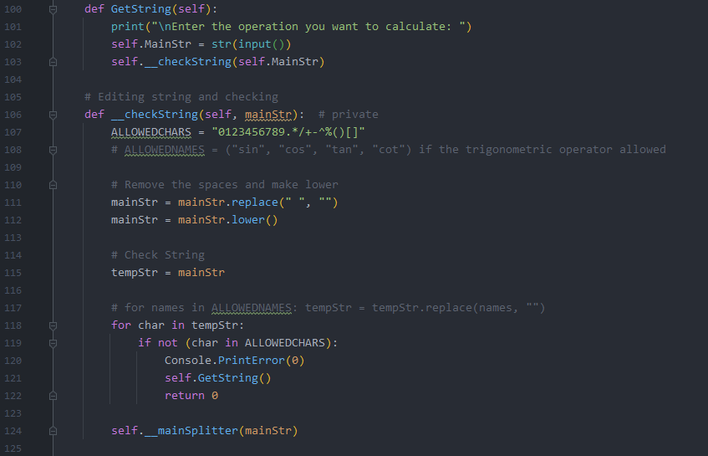
Step 1 Get and edit string
These two methods are created to get the string and then remove all spaces in the string. After that, checks string whether it contains not allowed chars or not. And then if everything is all right the function calls main method.

Slide 5
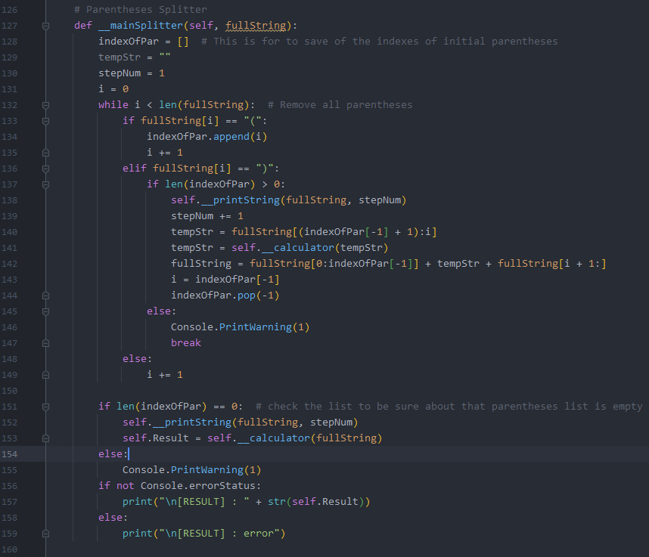
Step 2 Find the first closed parentheses
This method checks and saves indexes of the opening parentheses, then when it found the first closing parentheses, it retrieves the range from the last opened parentheses index to the closing parenthesis index. So that, it achieves a string without parentheses. The function sends this string to calculator method. Calculator method sends a result of the specific calculations. And the function replaces return value with that interval. That loop continues until the find last closing parentheses. After the all closing parentheses removed, it does last calculation to find the result and print to screen.

Slide 6
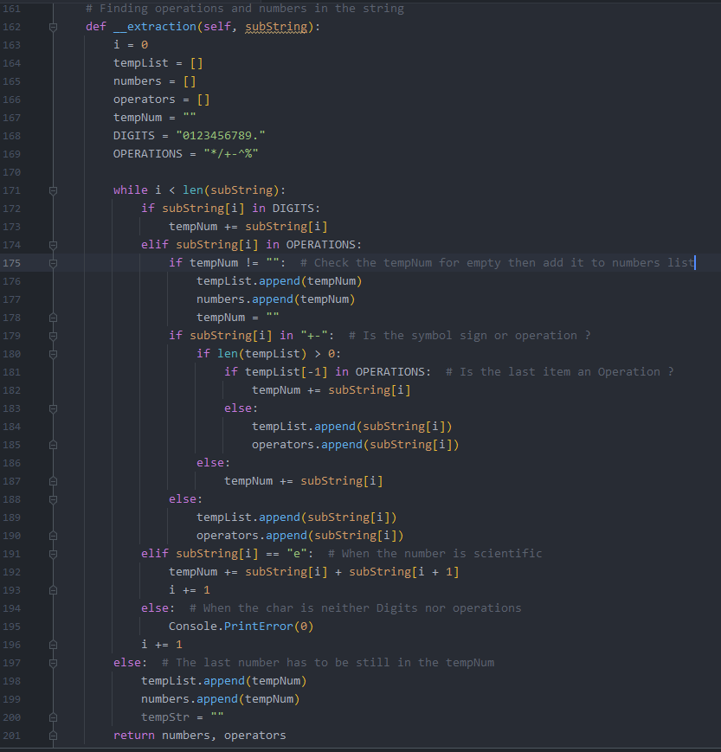
Step 3 Do math operations
Before doing the math operations the string has to be translated to two list as numbers and operators. Therefore the extraction method will handle this specific task. This method also works similar to Turing Machine. It starts from the most left char of the string then it adds the numbers, dot and also ‘e’ (if number is either too big or too small the python’s math operators return scientific number like 4.04579e-08) to the temporary number until to find math operation symbol. To decide an operation is whether sign of number or arithmetic operation, it checks the last item of the temporary list. If the last item is an operation it accepts as sign of the next number, else it accepts as operation.
(i.e. “ 45 + -15 ”, ‘-’ is not arithmetic op. it is the sign of the next number).

Slide 7
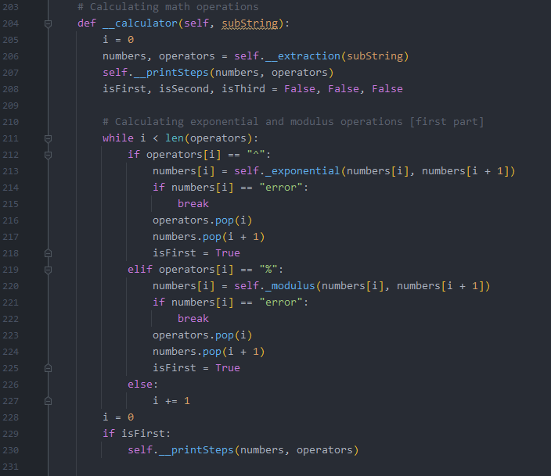
Step 3 Do math operations
After the numbers and operators are decomposed calculator method handles the next steps. It starts with exponential and modulus operations. The while loop detects all mod and exponential operations in the operators list, then it replaces and removes in the numbers list, also removes done operators in the operators list. This steps applied to multiplications and divisions then additions and subtractions operators. At the end of the all operations, 1 item left in the numbers list and calculator method returns it.

Slide 8
Contact Information
Github : https://github.com/enadream
Linked in : https://linkedin.com/in/enadream
Website : https://enadream.com (under preparation)

